Slide 1
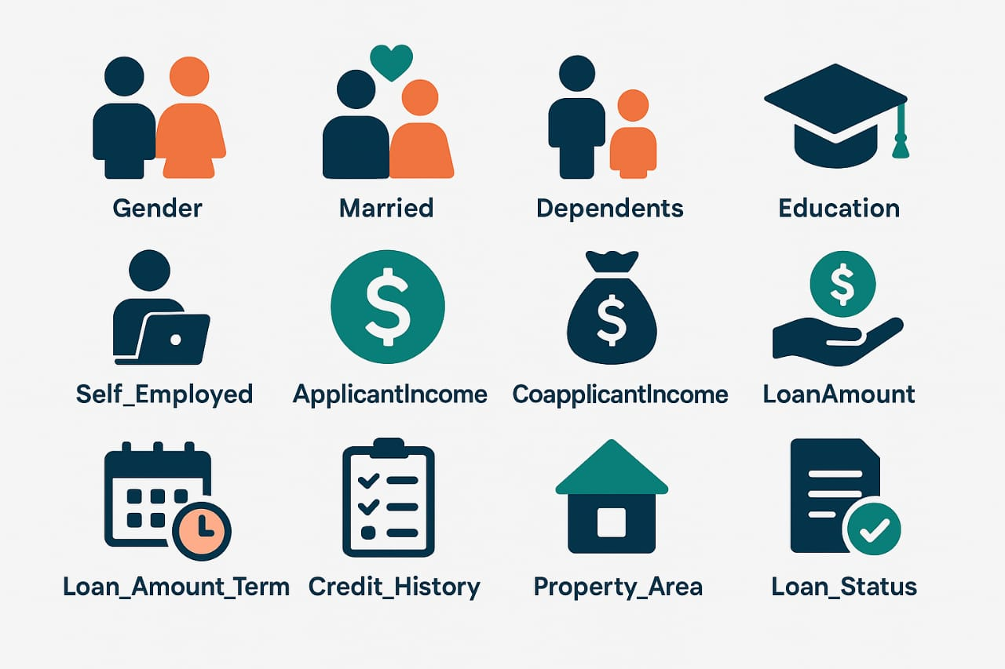

Loan Approval Analysis
Exploratory Data Analysis (EDA)
on Loan Approval
CODE FILE
By : Madhu Raj

Slide 2
Project Overview
Dataset Size : 367 rows × 12 columns.
Objective : Understand borrower characteristics & factor influencing loan approval.
Approach : Exploratory Data Analysis (EDA) using Python, Pandas, Matplotlib, Seaborn.

Slide 3
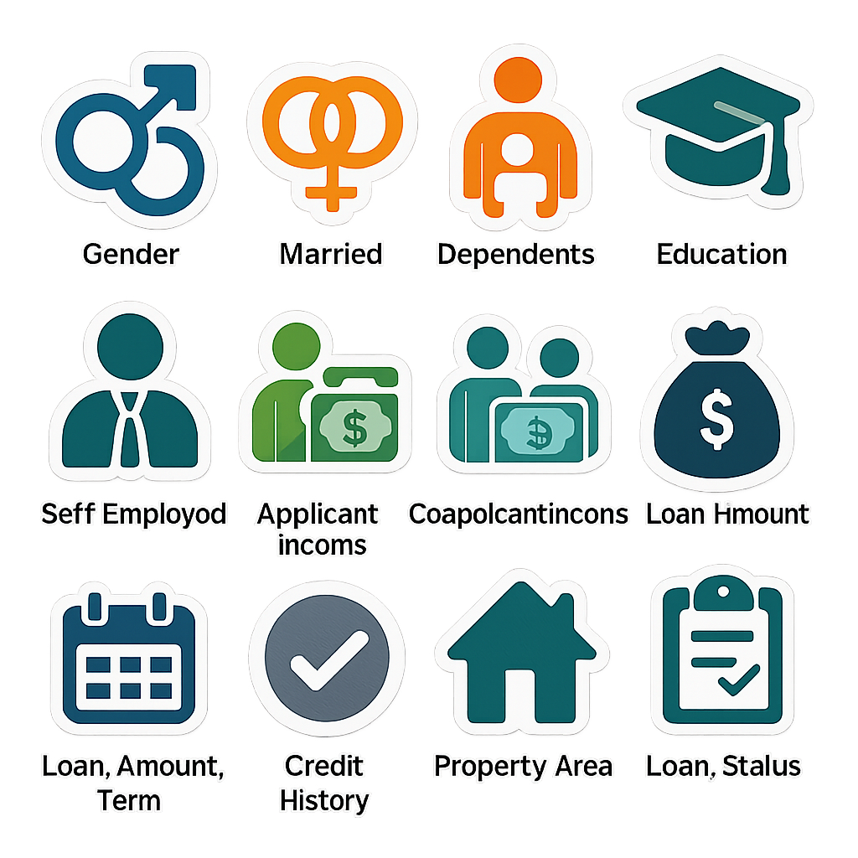
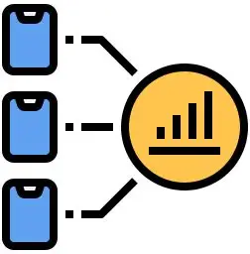
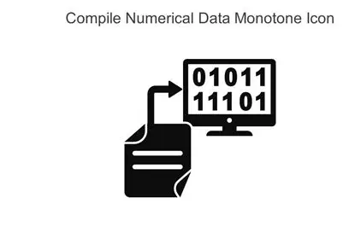
Dataset Columns
Categorical : Gender, Married, Dependents, Self_Employed, Property_Area, Loan_Status.
Numerical : ApplicantIncome, CoapplicantIncome, LoanAmount, Loan_Amount_Term, Credit_History.
Each column contributes to applicant profile & loan decision.

Slide 4

Data Cleaning & Preparation
Handled missing values (filled by MODE to these columns : Gender, Dependent, Self_Employed, Loan_Amount_term, Credit_History . LoanAmount by MEDIAN).
Encoded categorical variables for analysis.
Outliers Treatment : there are no such outliers that needs be handle. Some are there but seems realistic.
Dataset ready for visualization & insights.

Slide 5
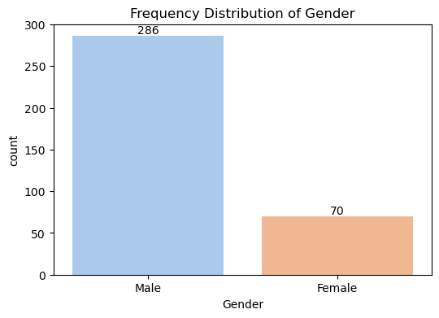
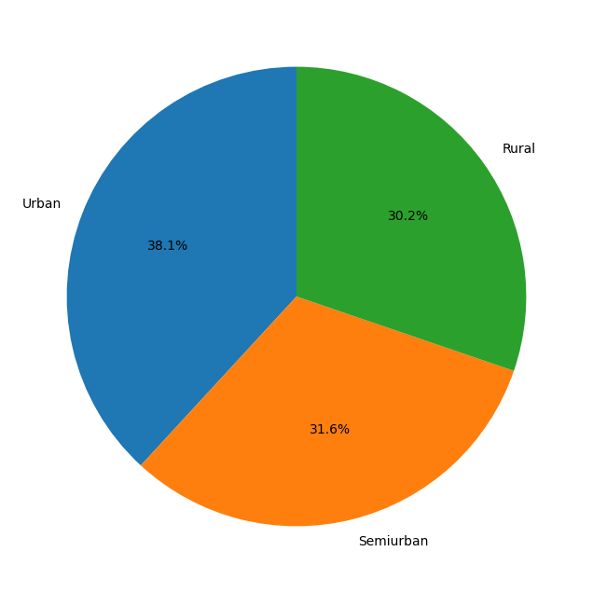
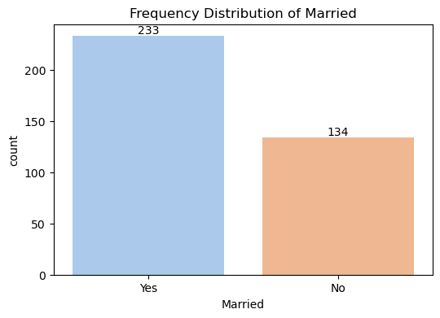
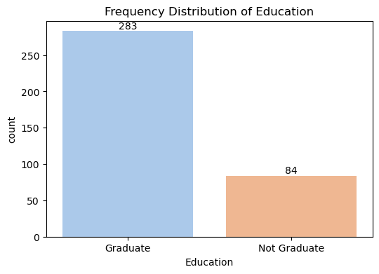
Univariate Analysis
Loan Amount: the average is 135.98 .
Gender: Majority applicants are Male.
Married: Most applicants are married.
Education: Graduates dominate the dataset.
Majority are Self Employed.
Mostly have Credit History.
Also, mostly Property Area belongs to the Urban
and the gap between semiurban & Rural is low.

Slide 6
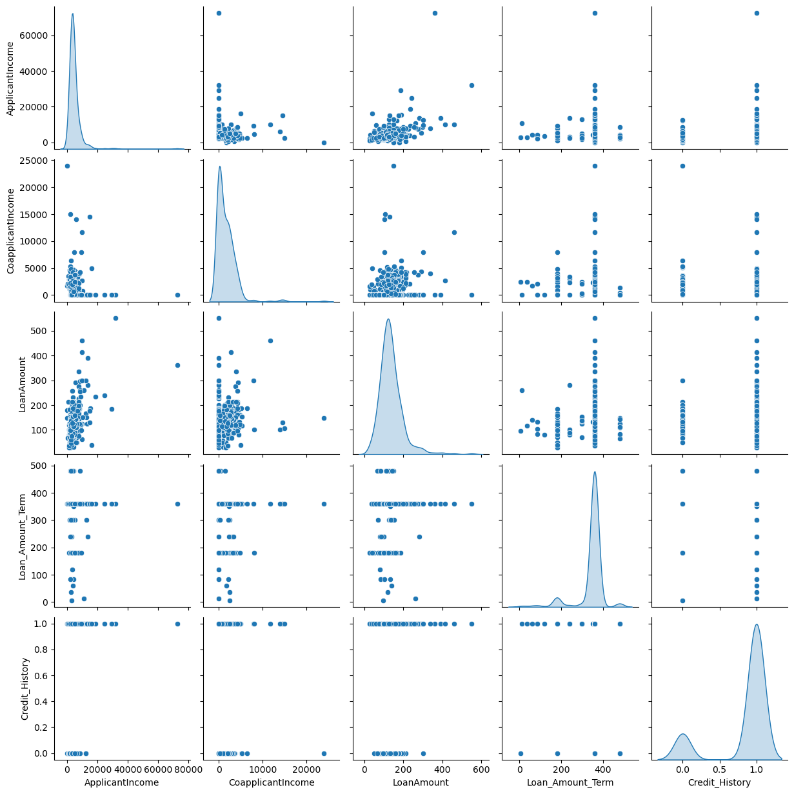
Bivariate Analysis
Mostly Male have higher loan amount.
Mostly Married are getting higher loan amount.
Graduates are getting higher loan .
Semi-Urban has the highest Loan Amount.
No strong correlation, applicants’ income and co-applicants’ income are independent.
Loan amount shows mild correlation with incomes, but not very strong.
Most applicants prefer standard loan tenure (360 months)
regardless of loan size.
Credit history is imbalanced → majority applicants have
history = 1, which is crucial for approval decisions.
Outliers exist in income & loan values, but they are not
extreme and appear genuine.

Slide 7
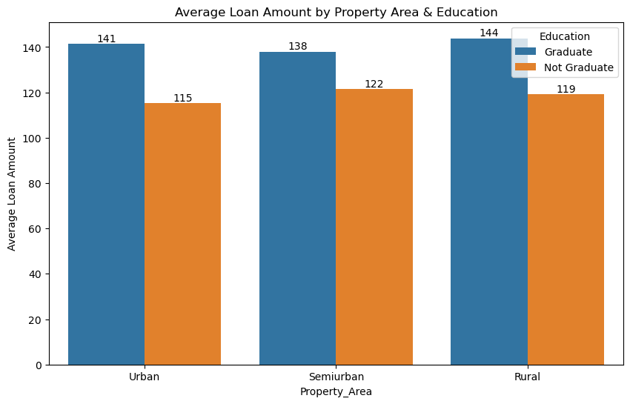
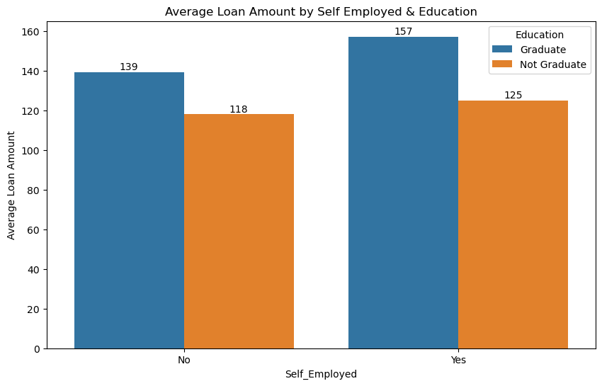
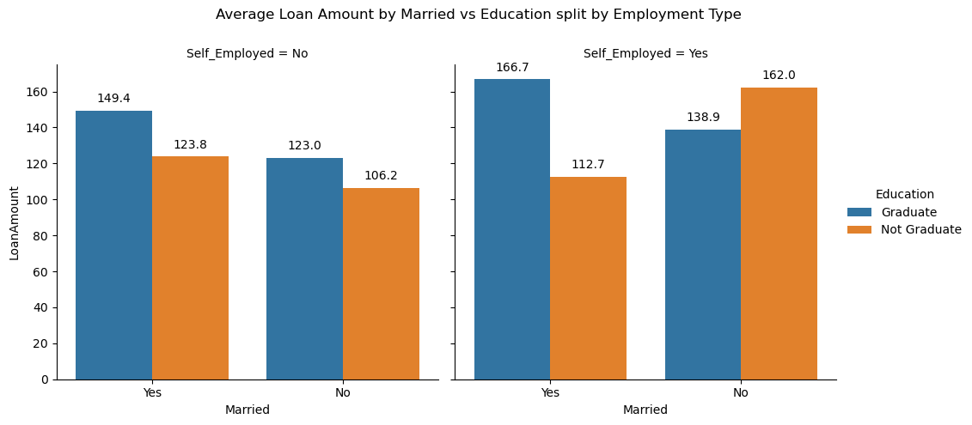
Multivariate Analysis
Married graduates (especially self-employed) receive higher average loans.
Not married, not graduates but self-employed → surprisingly high loan averages (indicate imbalance or special cases).
Employment type plays a crucial role when combined with education & marital status.
the education significantly impact the loan amount sanctioned and this effect is most pronounced in rural areas.

Slide 8
Key Insights
Credit history is the strongest predictor of approval.
Married & graduates are safer profiles for banks.
Urban & semi-urban properties attract higher loan approvals.
Self-employed applicants can secure higher loans but vary widely.
Applicant income has weak correlation with loan amount, while co-applicant income adds only minor impact
Some income and loan outliers exist but appear genuine → high-income groups taking larger loans.
Most applicants opt for the standard 360-month term, regardless of loan size.
A strong determinant → applicants with credit history = 1 dominate approvals.

Slide 9
Business Recommendations
Prioritize applicants with clean credit history.
Customize loan offerings based on marital status, education, and employment type.
Monitor self-employed applicants more carefully due to variability in loan sizes.
Use income patterns to design flexible repayment plans.
Applicant income should remain the primary metric.
Introduce flexible tenure options (shorter than 360 months) to attract high-income applicants unwilling to commit long-term.
Ensure accurate collection of loan amount and credit history during application, reduces ambiguity for approvals.
Monitor outliers (very high incomes or very large loans) separately → may represent premium customers or riskier bets.

Slide 10
Thank You

